Slide 1


Comparing Neighborhoods: New York vs Toronto

Slide 2

Comparing Neighborhoods Valuable to Traveler
Travel is a multibillion-dollar
Two types of travelers:
Just like home (want the same comforts from home)
Adventurous (wants to experience new cuisines, etc.)
Advanced planning can improve the travel experience
Compare neighborhoods in cities to identify neighborhoods to visit or to avoid
Present on a map to make ease of comparison possible

Slide 3
Data Acquisition and Cleaning
Neighborhood data for New York and Toronto:
https://cf-courses-data.s3.us.cloud-object-storage.appdomain.cloud/IBMDeveloperSkillsNetwork-DS0701EN-SkillsNetwork/labs/newyork_data.json
https://en.wikipedia.org/wiki/List_of_postal_codes_of_Canada:_M
latitude and longitude for Toronto
https://cocl.us/Geospatial_data/Geospatial_Coordinates.csv
Data sets need to be read, cleaned and transformed 4 features: borough, neighborhood, latitude, and longitude.
Foursquare api
https://api.foursquare.com/v2/venues/explore?

Slide 4
K-means clustering
5 clusters
from sklearn.cluster KMeans
59 neighborhoods in total
Toronto (19)
New York (40)
3 cluster analyses
Toronto, New York, Toronto + New York

Slide 5
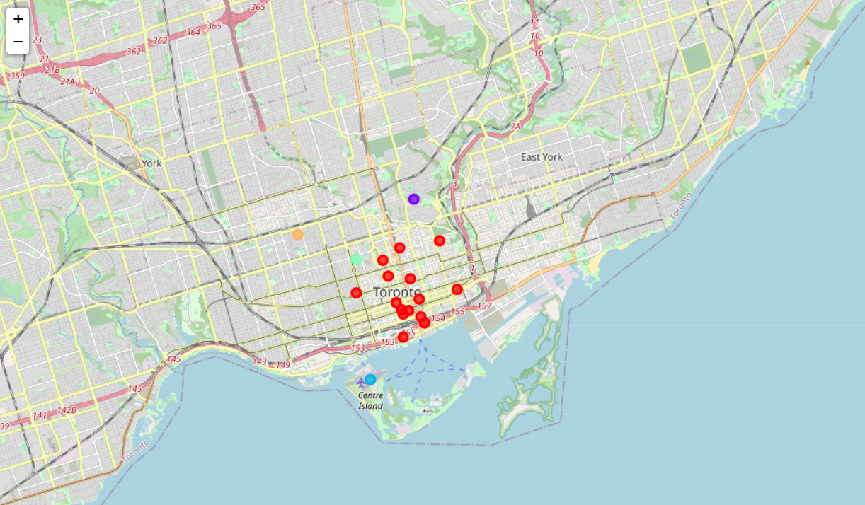
Downtown Toronto (clustered separately)

Slide 6
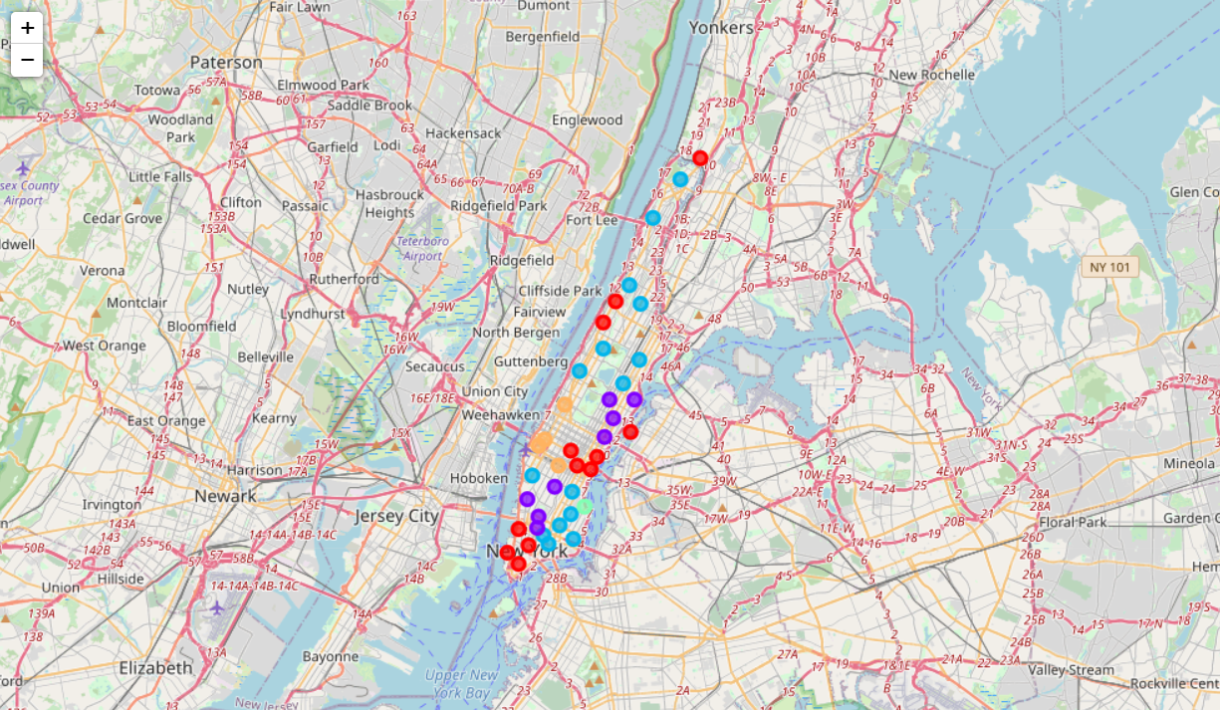
Downtown New York (clustered separately)

Slide 7
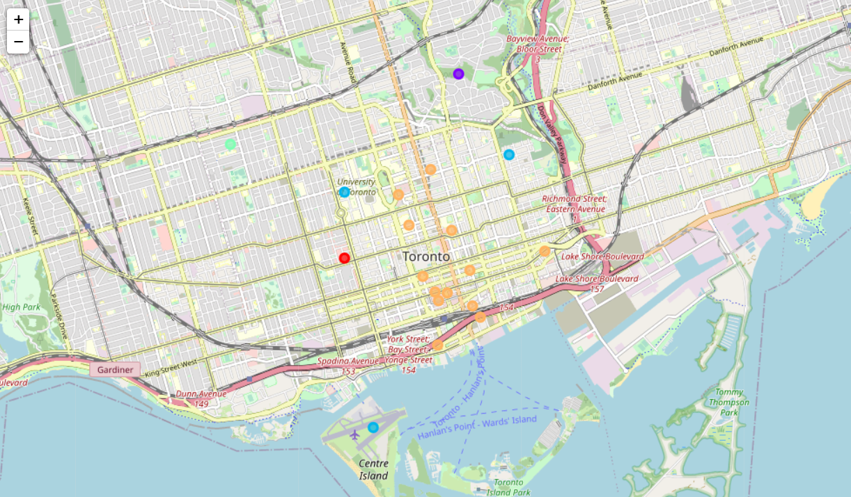
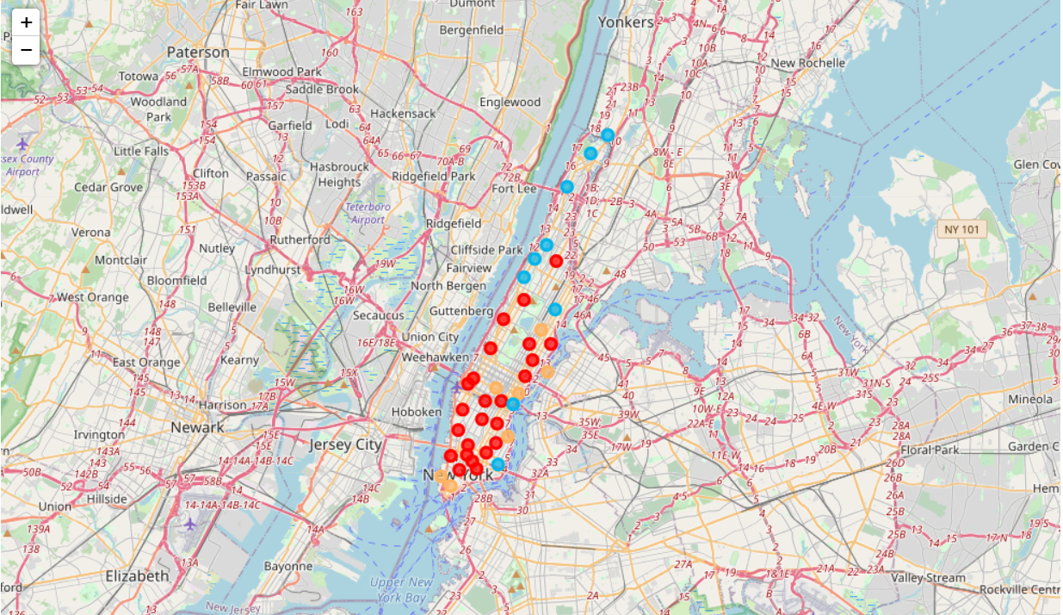
Downtown New York and Toronto (clustered together)

Slide 8
Conclusions and Future Work
Downtown New York and Toronto
Can identify similar and dissimilar neighborhoods to improve travel experinece
Surprising insight
New York and Toronto are very differently organized
Toronto has an inner and an outer downtown area
New York has multiples areas for each cluster
This is a novel result and warrant further investigation and refinement

